Slide 1
Selling Like Hot Brakes
NO TECH

Slide 2
Click on the Kahoot icon below to begin the quiz.
Alternatively, you can use EdPuzzle.
SELLING LIKE HOT BRAKES | FEBRUARY 18, 2022 EDITION | NEXT GEN PERSONAL FINANCE

Slide 3
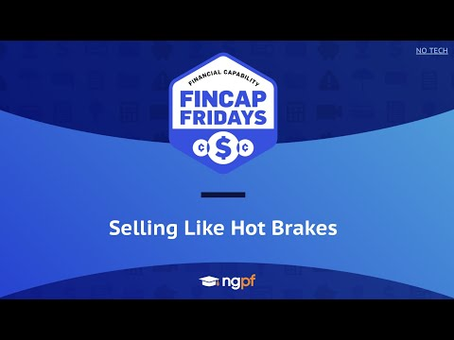
You’ve completed the exercise, now it’s time to learn
more about the current event:
SELLING LIKE HOT BRAKES | FEBRUARY 18, 2022 EDITION | NEXT GEN PERSONAL FINANCE

Slide 4
Discussion Prompt:
Would you buy a brand new car instead of saving money by purchasing a used car in good condition? Why or why not?
SELLING LIKE HOT BRAKES | FEBRUARY 18, 2022 EDITION | NEXT GEN PERSONAL FINANCE

Slide 5
Extend Your Learning
Relevant Resources from NGPF:
What has happened to used car prices over the past year? (Question of the Day)
INTERACTIVE: The Ethical Dilemmas of Self-Driving Cars (Activity)
Understanding Auto Loans (Lesson)
References:
Teens Find Rising Used-Car Prices Dash Hopes of First Car (WSJ)
82% of consumers are paying above sticker price for a new car (CNBC)
Why car prices remain so stubbornly high (CNN)
Auto loan debt doubled in the last decade, more than any other debt (Yahoo Finance)
Driving technology promises large safety benefits for teens (Global News Wire)
SELLING LIKE HOT BRAKES | FEBRUARY 18, 2022 EDITION | NEXT GEN PERSONAL FINANCE

